Slide 1
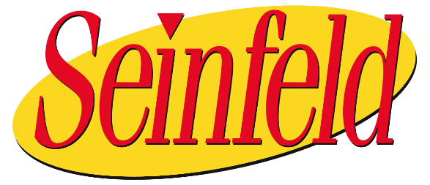
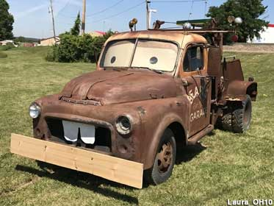

Black Team
HI
Congratulations
Meth. Not even once.

Slide 2
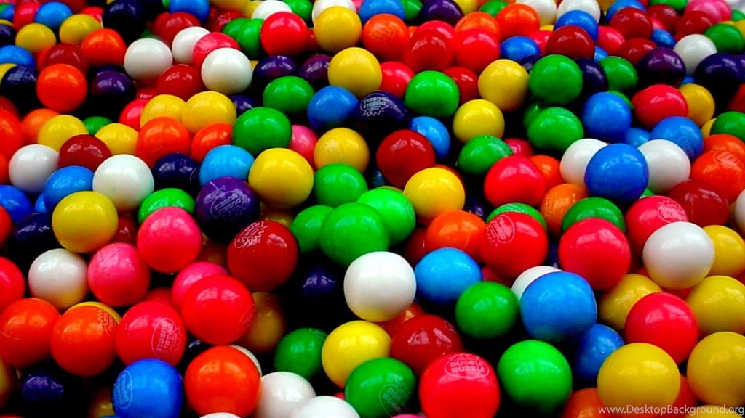
Black Team
HI
I’m James
Build Team:
Me
Davie
Jarrad
Jared
Brian
Jake (not from State Farm)
Emilio
Joe
Chris <- Swiss
Michael
*crowd goes wild*

Slide 3

Black Team
Infrastructure
Networking
Servering
Desktoping
All builds are fully secured and ‘optimized’ as a courtesy. ;-)

Slide 4
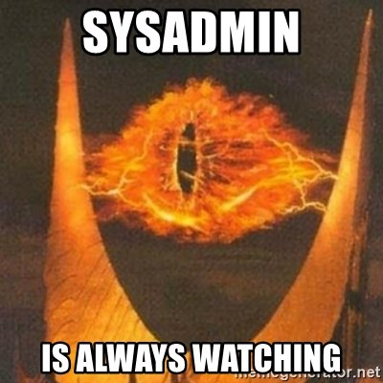
Black Team
Observations
More stress than last year.
Printing worked!
PAN firewall usage. *thumbs up*
Few password changes. *thumbs down*
Very quiet.
No one got mad at us (we think).

Slide 5
Black Team
Recommendations
Checklists with schedules
Account audit with monitoring.
Spend time doing smart/effective things rather than the ‘right’ things.
i.e. If listening on VNC, put up host firewall rather than tracking down a persistent daemon (initially).
Egress filtering (or at least monitoring).
SOCKS proxy? TinyProxy? Apache?
Firewall advanced features (Threat, A/V, URL Filter).

Slide 6
Black Team
Recommendations
Network segmentation with zones/VLAN’s. DMZ
Note starting behavior of all critical services
What does the front page of my HTTP/S page look like?
Backup of configuration for critical services
Zip and tar take longer to type than run
Offline storage on USB
Etckeeper with version control (SVN, Git)
Operating system is irrelevant to public service
Subject Matter Expert (SME) vs. cross-training

Slide 7
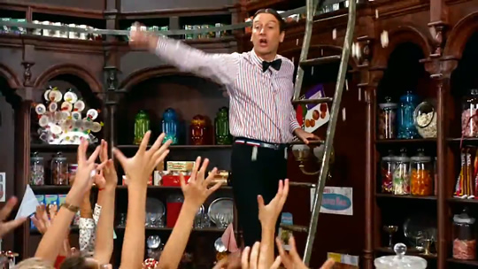
Black Team
Topology
Initial Scenario: Bob’s Candy Factory
The name of the candy store where Charlie bought the infamous Wonka bar.
Contained a factory monitoring system.
GIANT RED BUTTON
BLINKY LIGHTS
NUCLEAR LAUNCH KEY

Slide 8
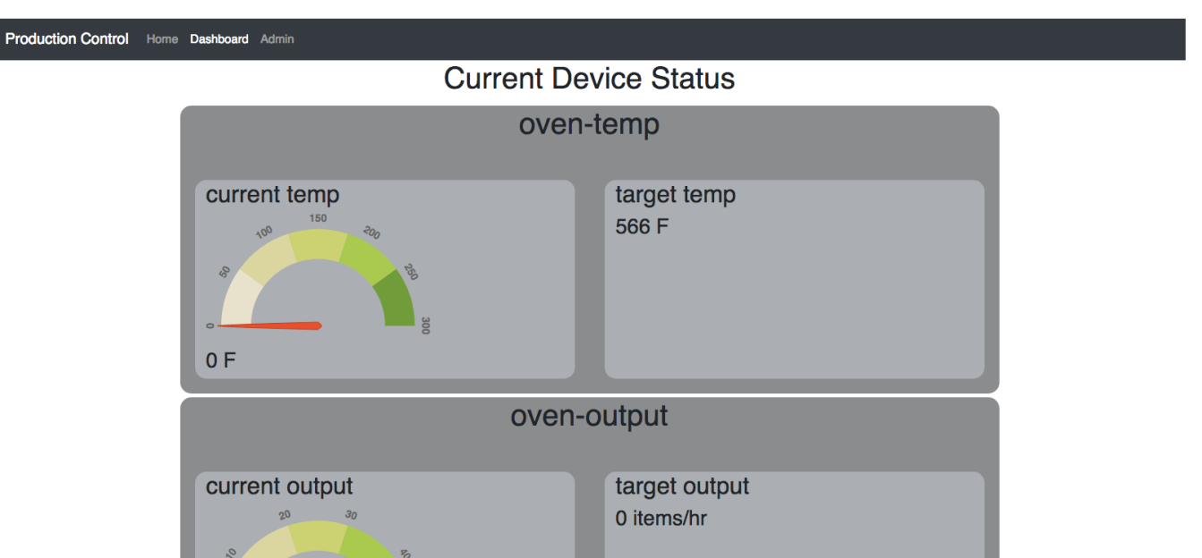
Black Team

Slide 9

Black Team
Topology
First Acquisition: Jerrys Candy
Based on Seinfeld.
(For those under 30 years old) Seinfeld was a television sitcom literally about nothing.
Meant to act as a remote store front with several POS terminals.

Slide 10
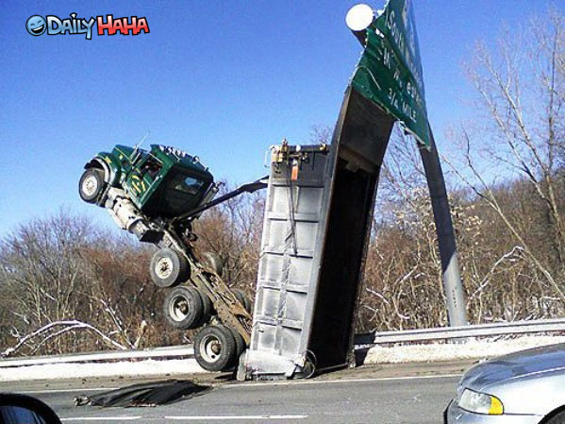
Topology
Second Acquisition: Trusty Trucking
SURPRISE
Extra care was taken to make sure Torque was more in play.

Slide 11
Black Team
Topology
Largest number of concurrent hosts to date
38 hosts
(Not the) Largest number of concurrent services to date
24 services
Required DNS service dependency for several systems

Slide 12
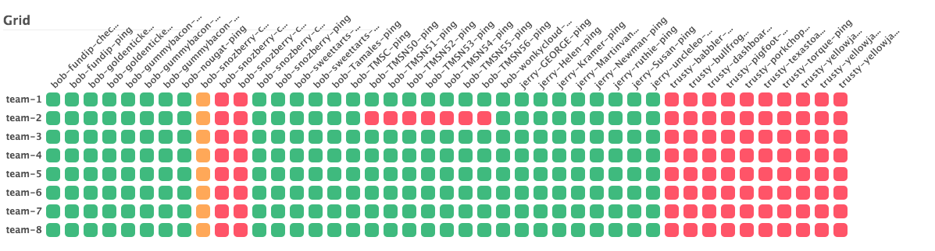
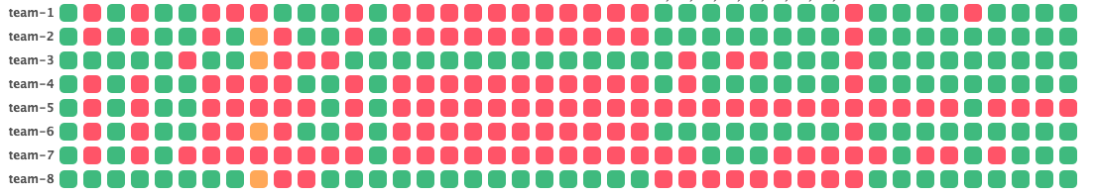
Black Team
BEFORE WE STARTED
AFTER YOU TOUCHED THEM

Slide 13
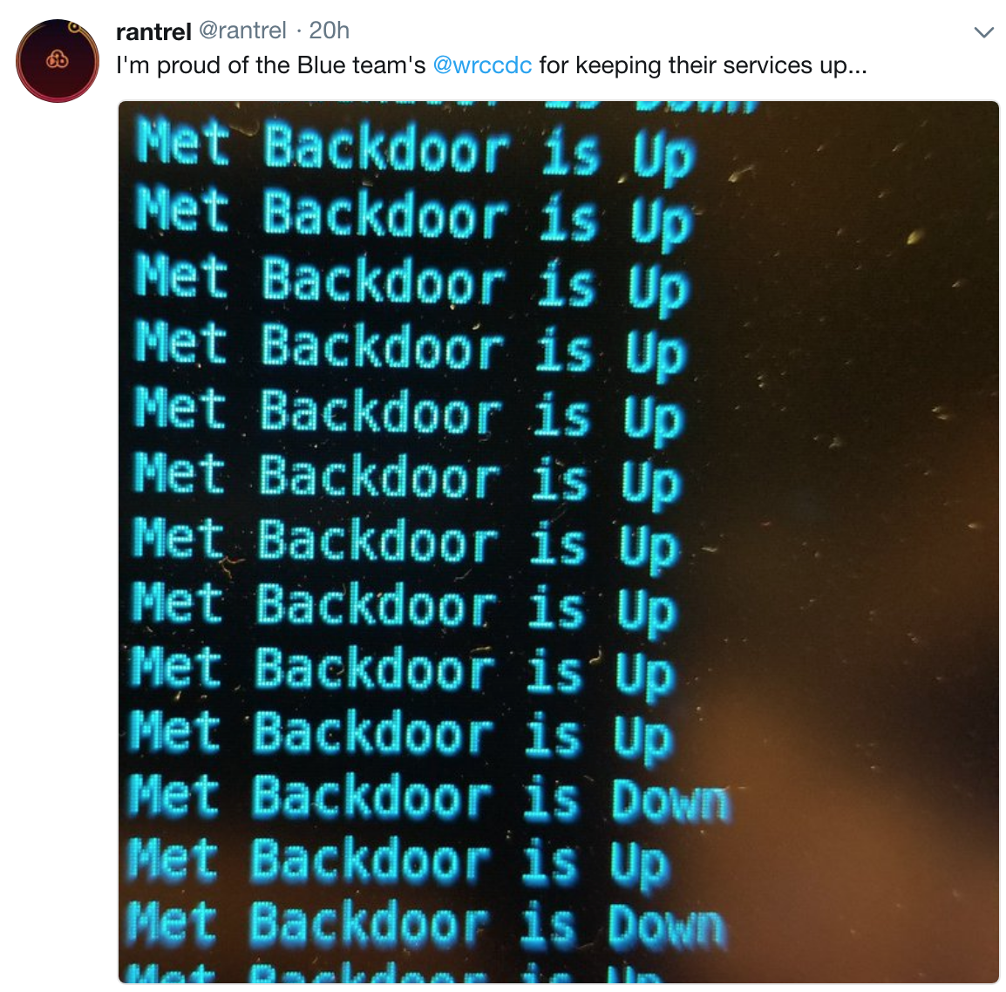
Black Team
You guys weren’t monitoring your shells, so we had to…

Slide 14
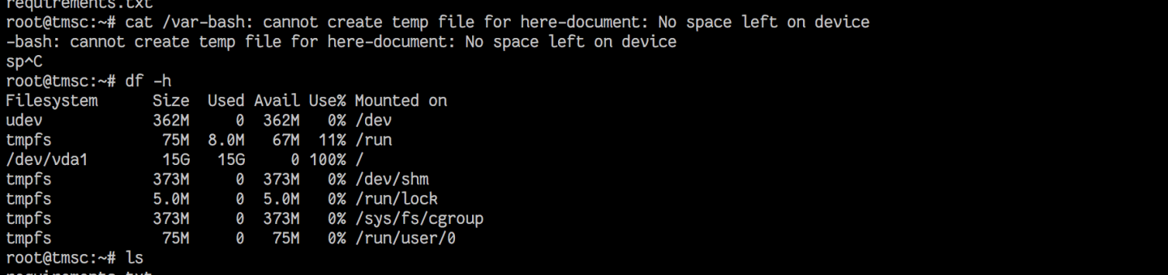
Black Team
Fun Stuff
“I’ll just write this log line her…oh wait…”

Slide 15
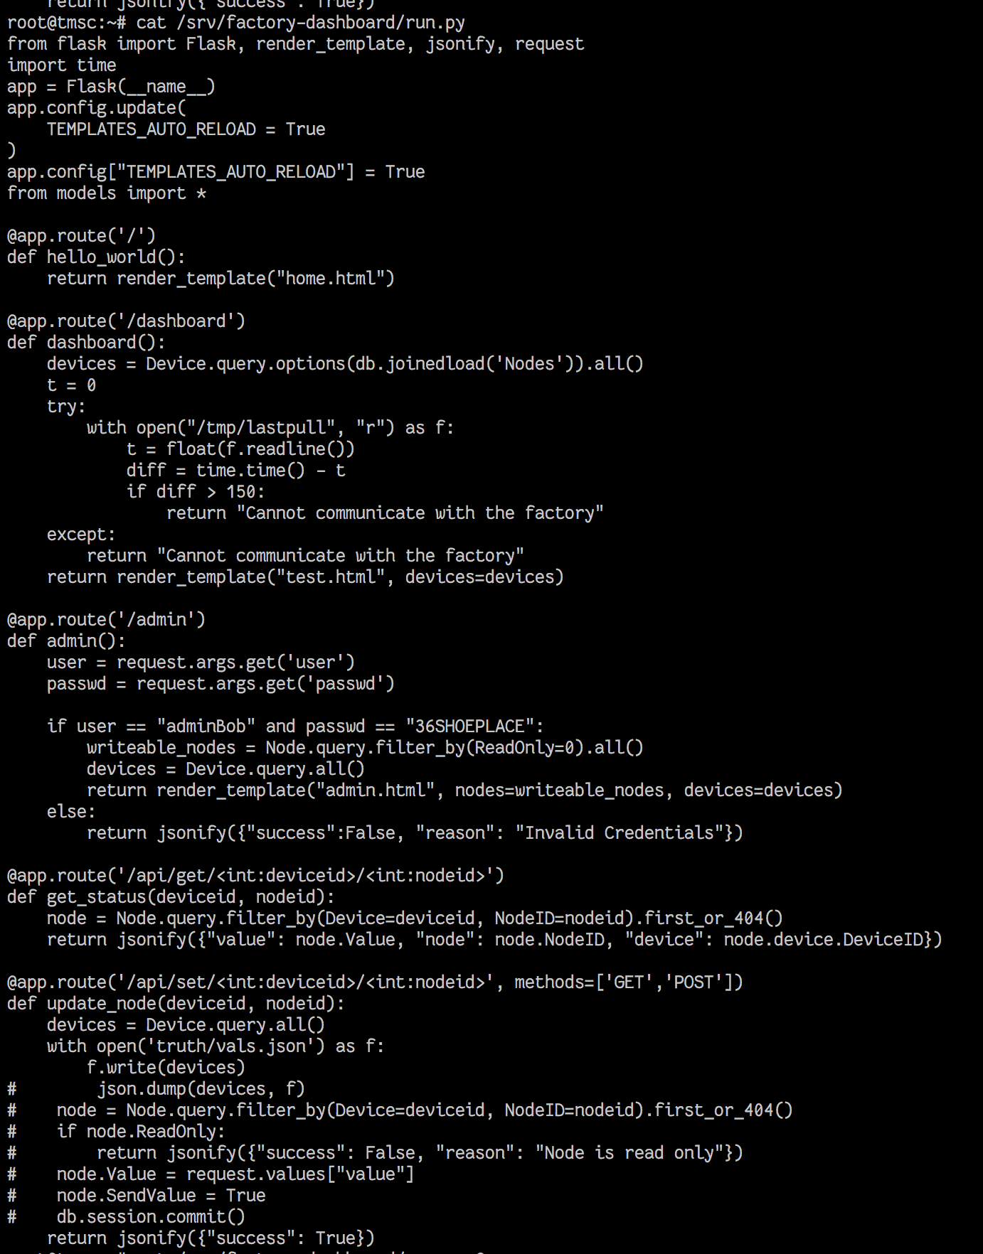
Black Team
Fun Stuff
API commented to never make changes. Even when the factory explodes.

Slide 16
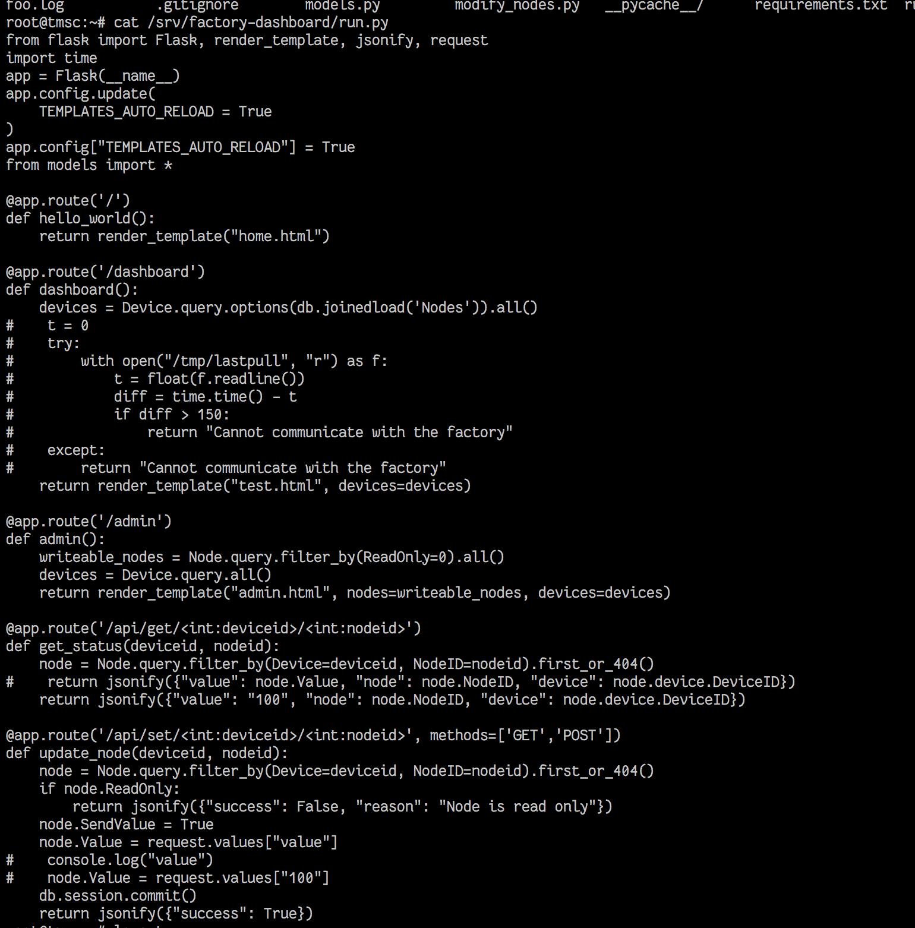
Black Team
Fun Stuff
API commented to ignore communication problems with factory.
Even when the factory explodes. (All Red LED’s, Factory Health Check Passing)

Slide 17
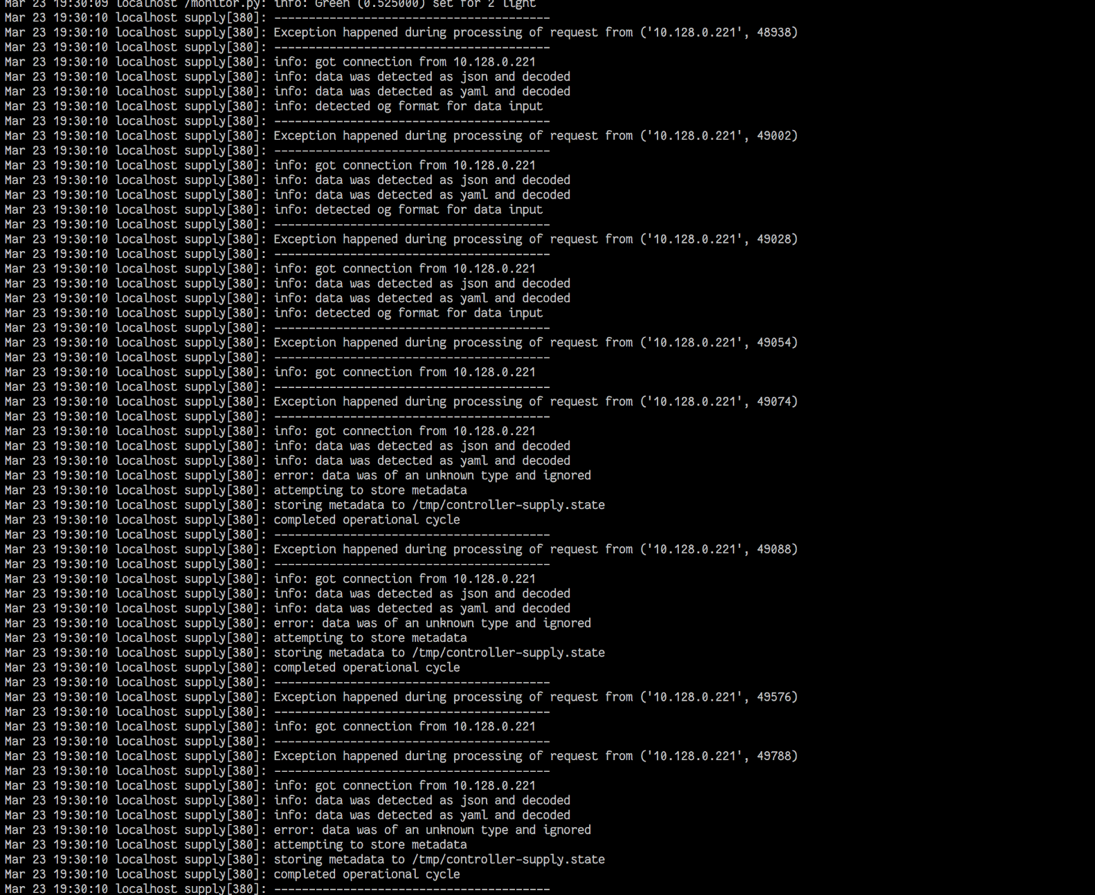
Black Team
Fun Stuff
Red team trying to fuzz the controller. Luckily we have expert API
developers who simply ignore every exception.

Slide 18
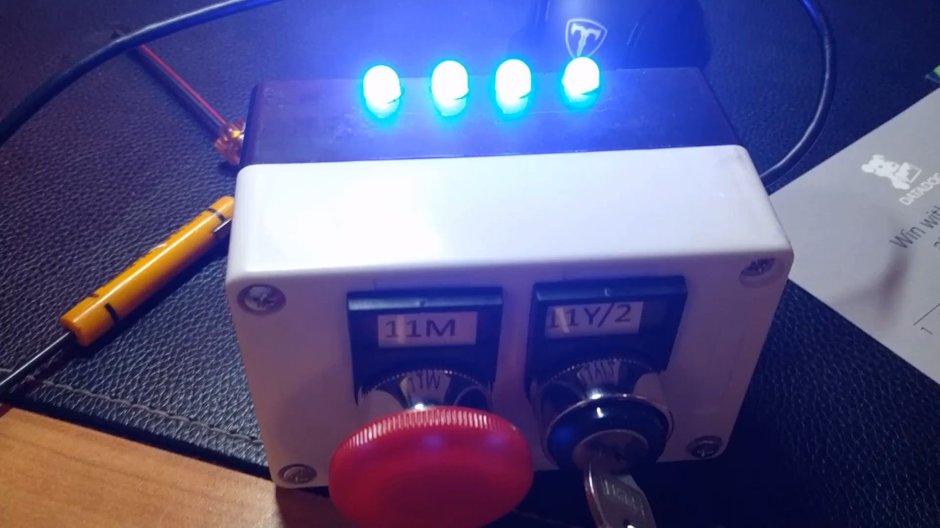
Black Team

Slide 19
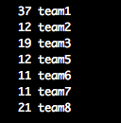
Black Team
“Boom!”

Slide 20
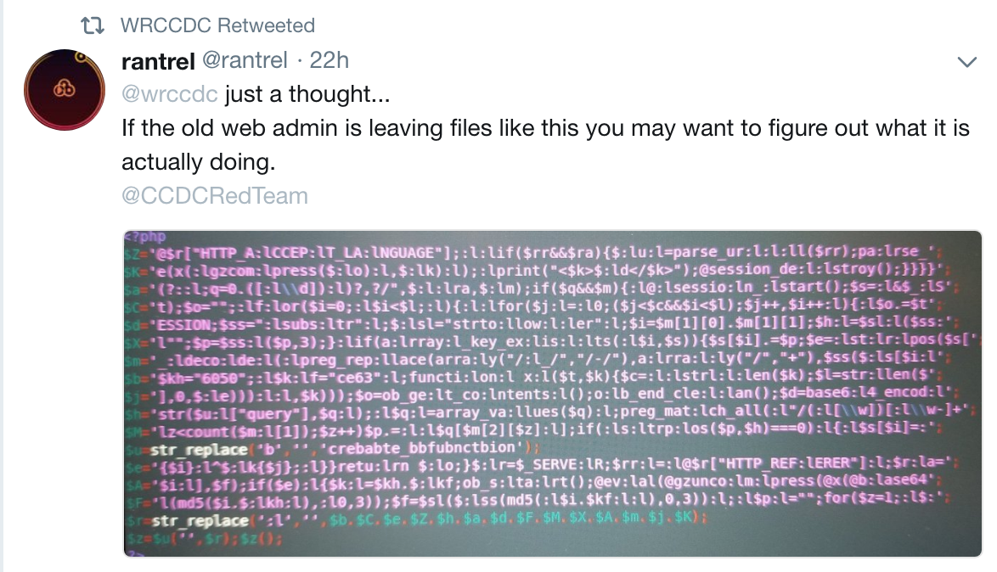
Black Team
Fun Stuff

Slide 21
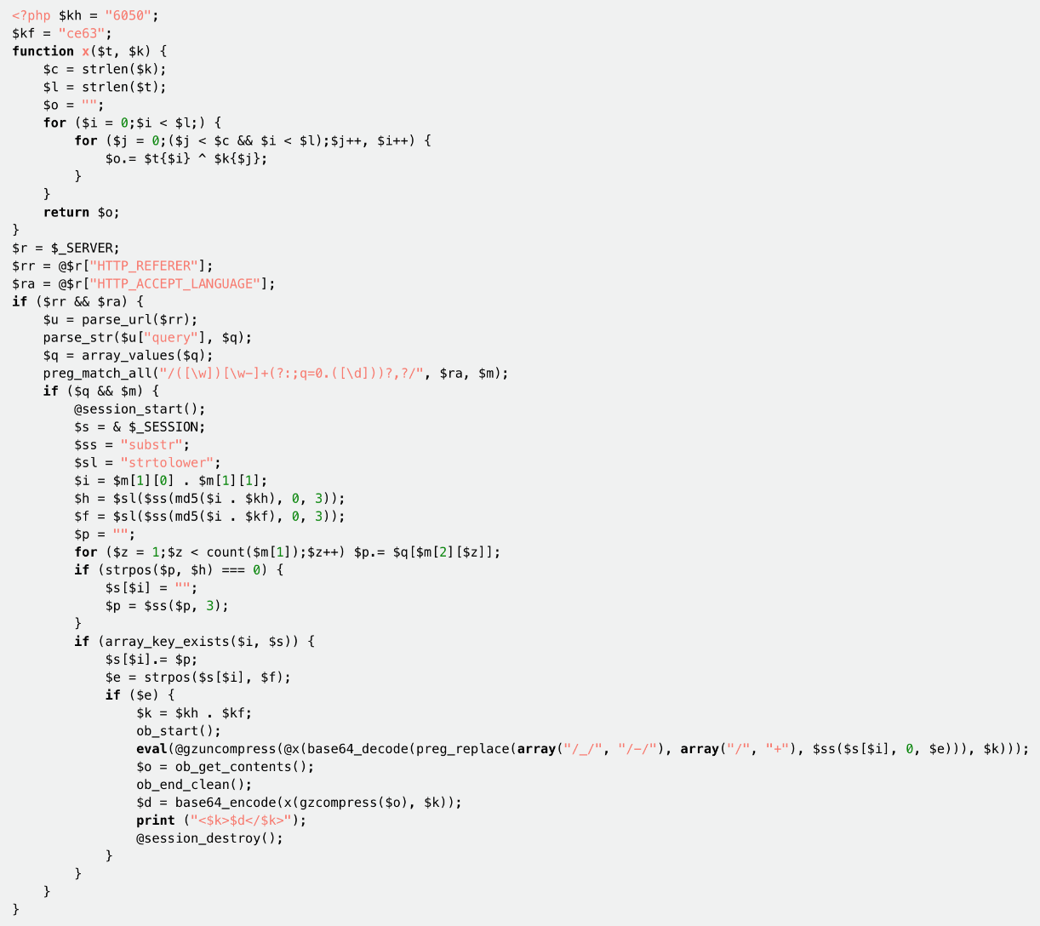
Black Team

Slide 22
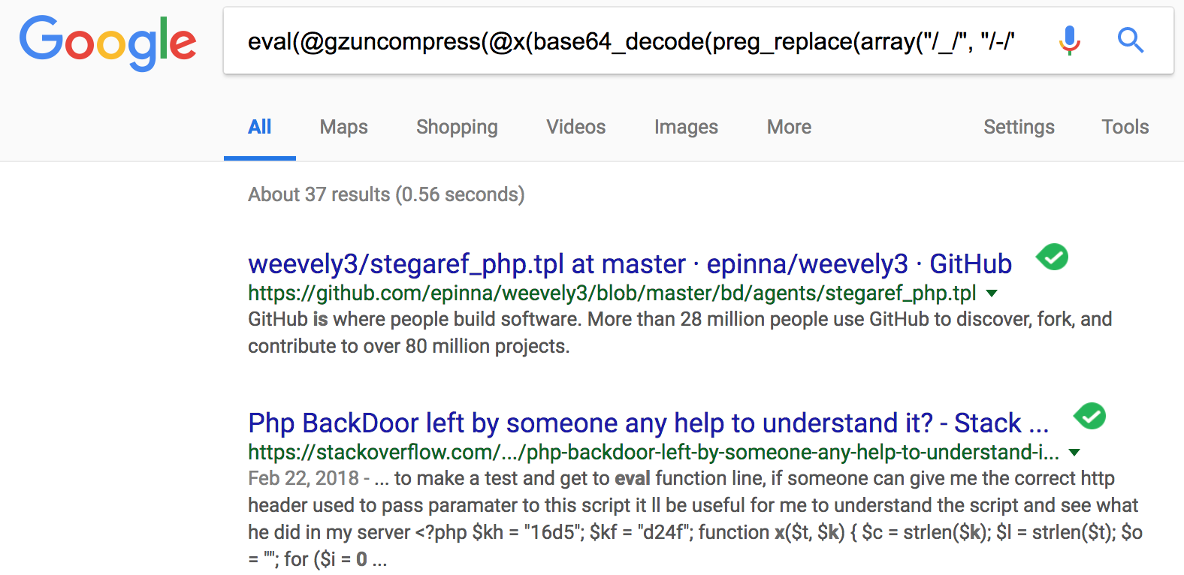
Black Team

Slide 23
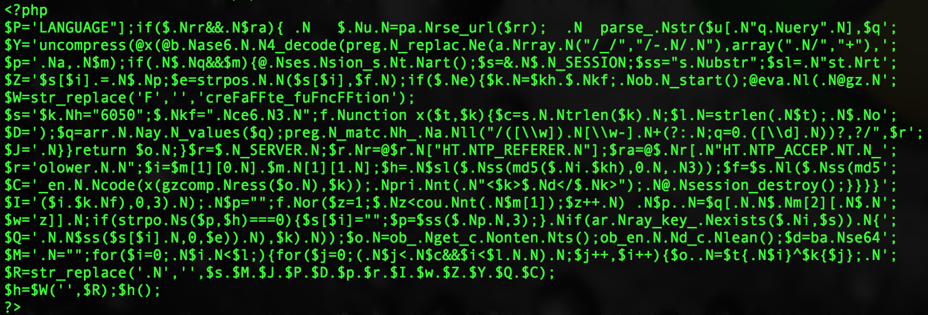

Black Team
Fun Stuff

Slide 24
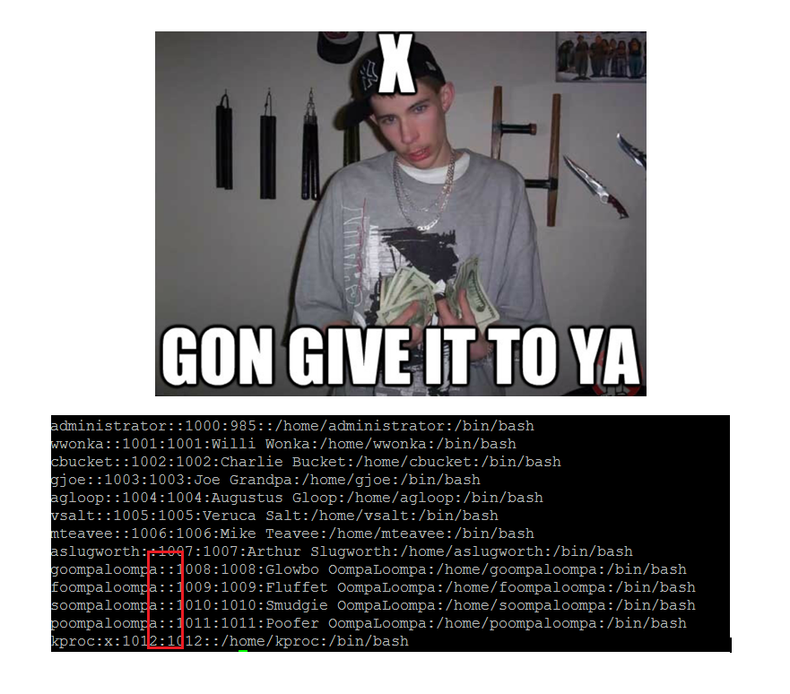
Black Team
Fun Stuff

Slide 25
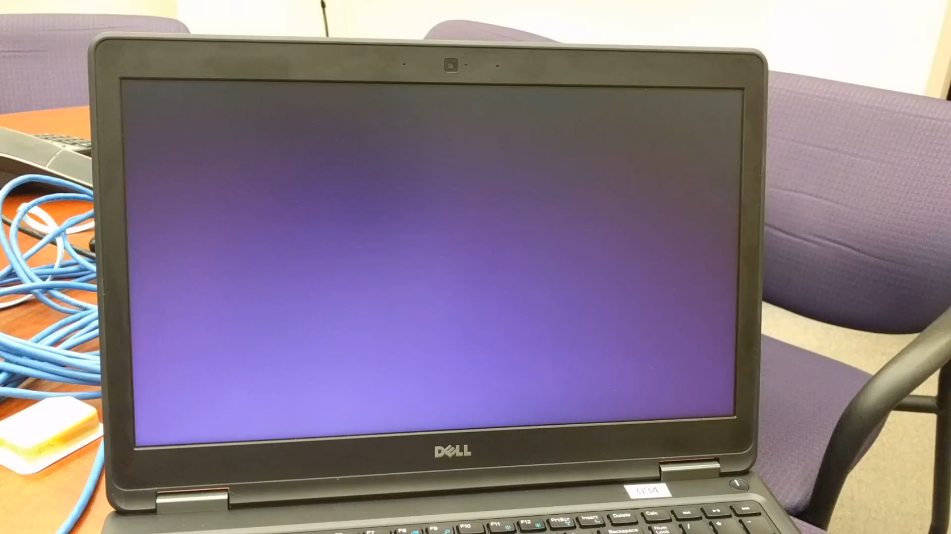
Black Team

Slide 26
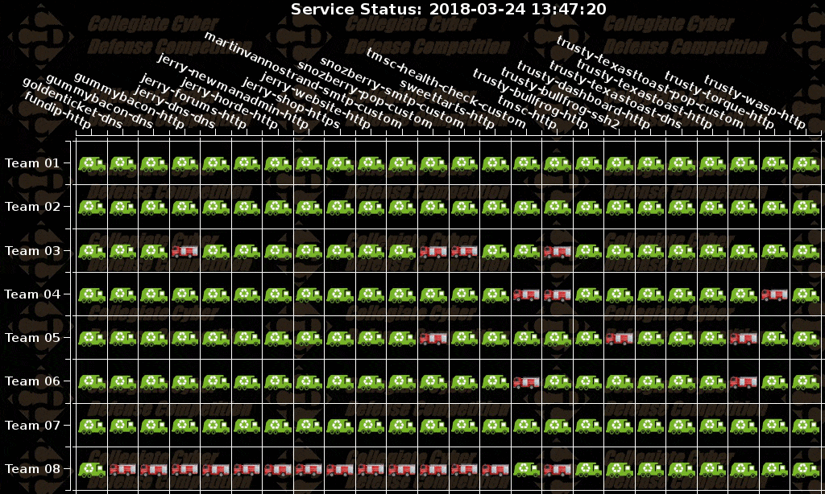
Black Team

Slide 27
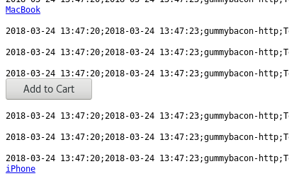
Black Team
Fun Stuff
“just gonna add this log line to my cart....”

Slide 28
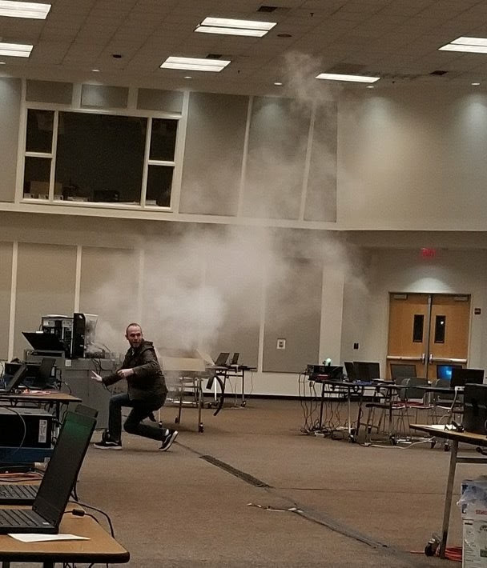
Black Team
Fun Stuff

Slide 29

Black Team
Questions? Comments?
james@wrccdc.org

